Slide 1
Airbnb Price Predictor Model
Sampreet Bheemireddy and Vihan Agarwal

Slide 2
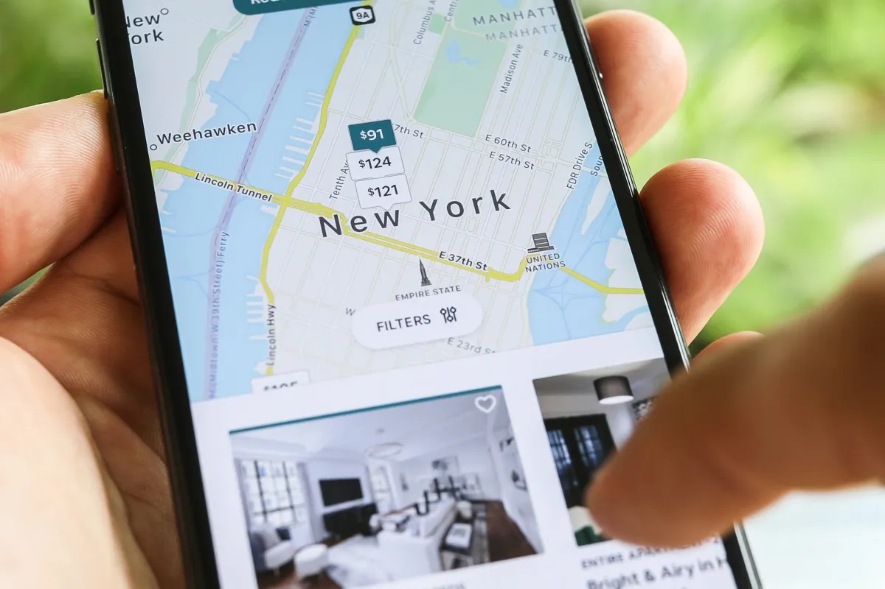
Purpose of our Model
Provide accurate prediction on how much a listing is priced at
Use both numerical and categorical features to develop this price prediction within certain price ranges
Provide a platform where users can input the information of their property and get an accurate estimate of listing price

Slide 3
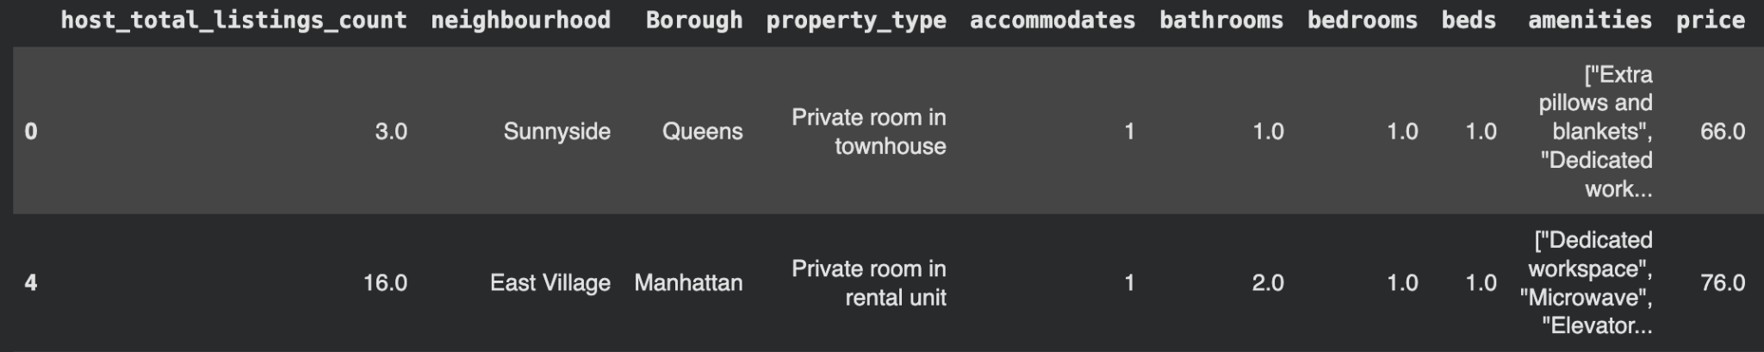
Our Data
Sample of our dataset (Includes many more features)
From Inside Airbnb
Data from all Airbnb listing in New York City
Includes host info, property features, location, and customer reviews
We cleaned the data set to only include the features we thought were most important

Slide 4
Data Preprocessing
Encoded categorical variables such as borough, property type, neighbourhood
Created engineered features: total capacity, bathroom-per-bedroom ratio, beds-per-bedroom ratio
Final dataset: 21 features across location, property attributes, and reviews
80/20 train-test split with stratification to maintain class balance
Our price range predictions have 4 ranges based on quartiles: Cheap, Medium, Expensive, and Ultra Expensive

Slide 5
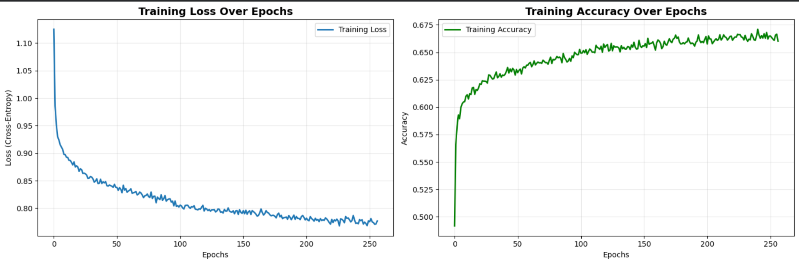
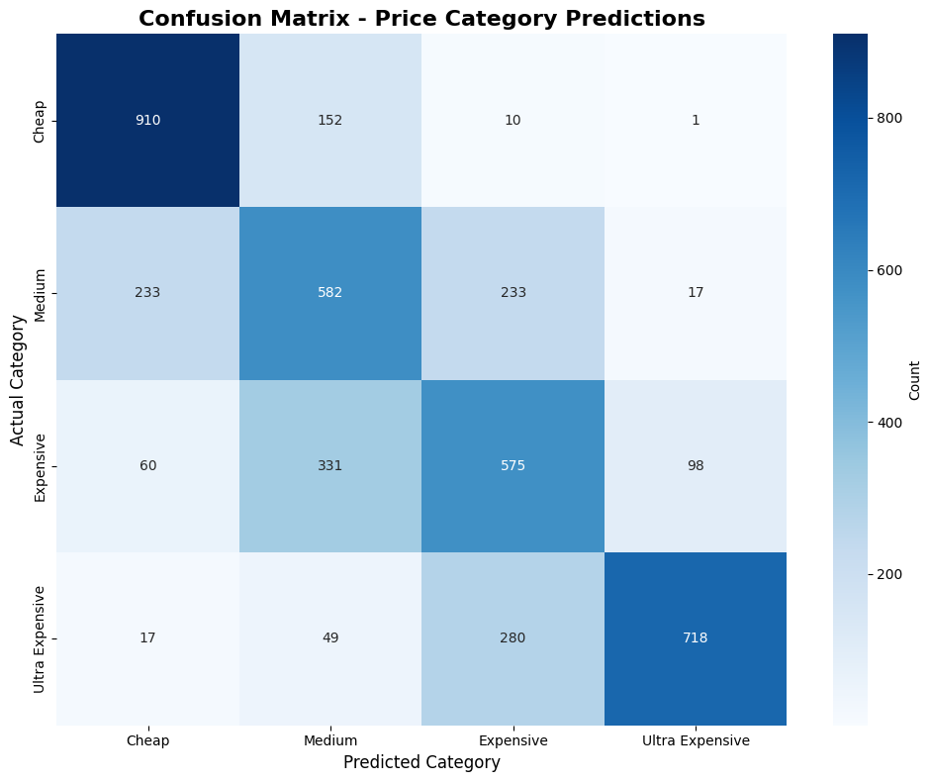
Neural Networks Model
Deep Neural Network (Pytorch)
Test Accuracy: 65.28%
Final Loss after epochs: .7723
4 hidden layers, 64 batch size, AdamW optimizer

Slide 6
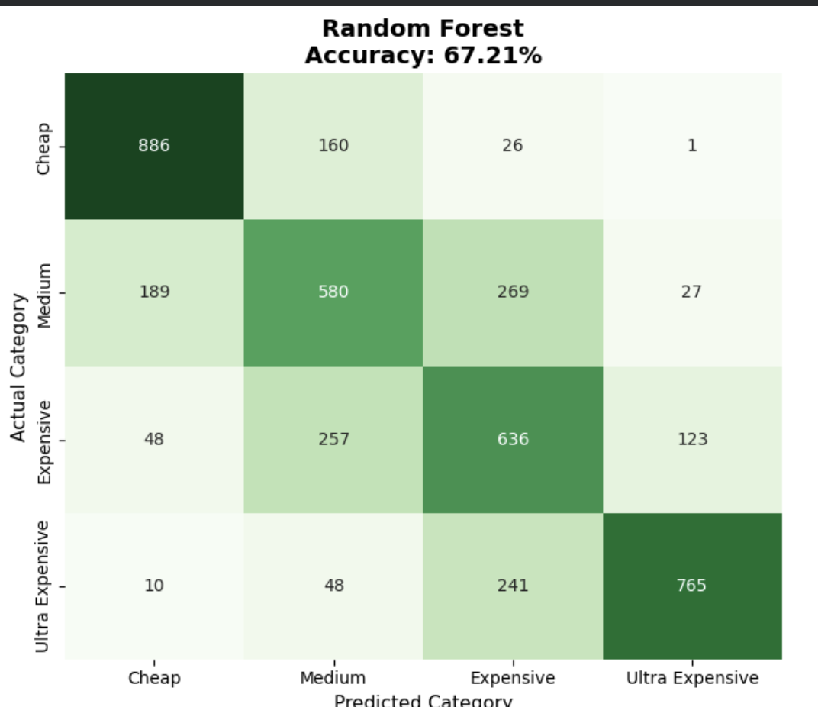
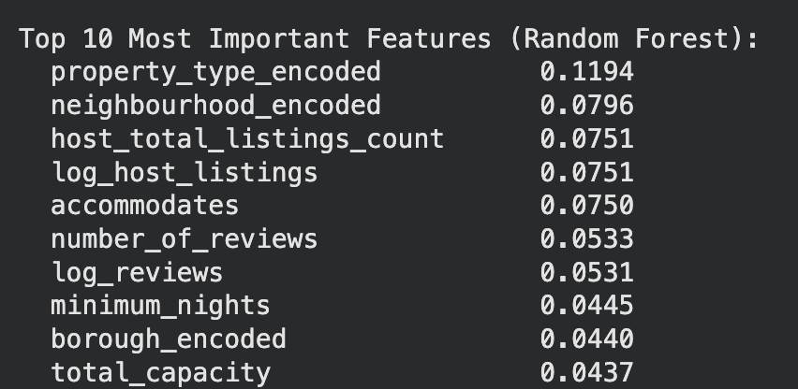
Random Forests Model
Random Forests
200 decision trees with maximum depth of 20
Trained on same preprocessed features
Provided feature importance rankings for interpretability

Slide 7
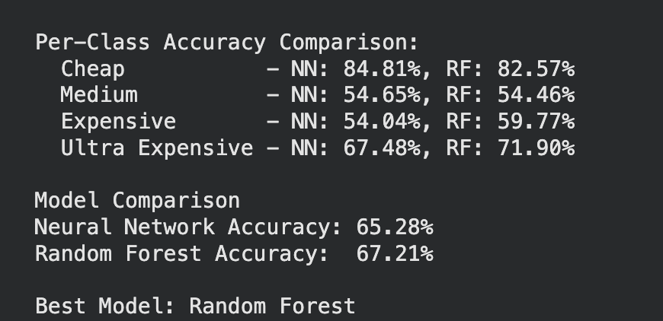
Model Comparison
Random Forest slightly outperformed neural network
Both models evaluated using accuracy, precision, recall, F1-score, and confusion matrices
Key predictive features: review scores, accommodates, bedrooms, borough
Our Chosen Model: Random Forests because of higher accuracy and better fit for our purposes

Slide 8
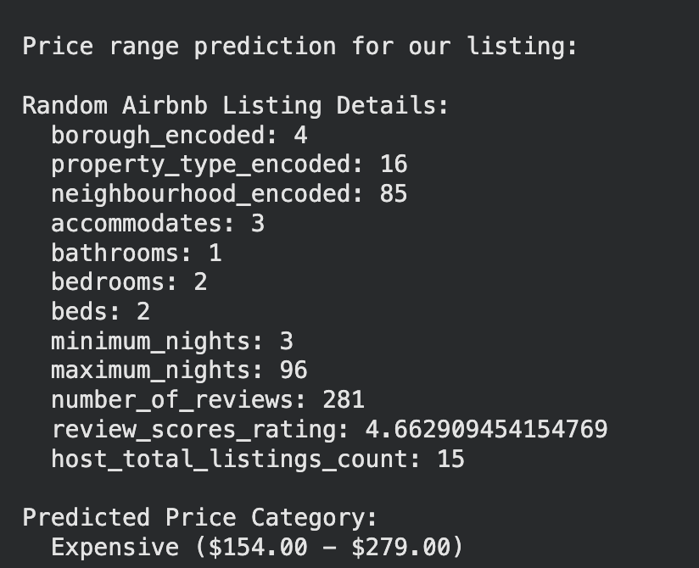
Our Listing Price Range Prediction
Predicted Price Range: Expensive
Using this information, we believe our property is worth between $154-$279 per night
This is quite the large range but we know it is from 50th-74th percentile in terms of value
Our property is in Fresh Meadows, Staten Island

